Slide 1
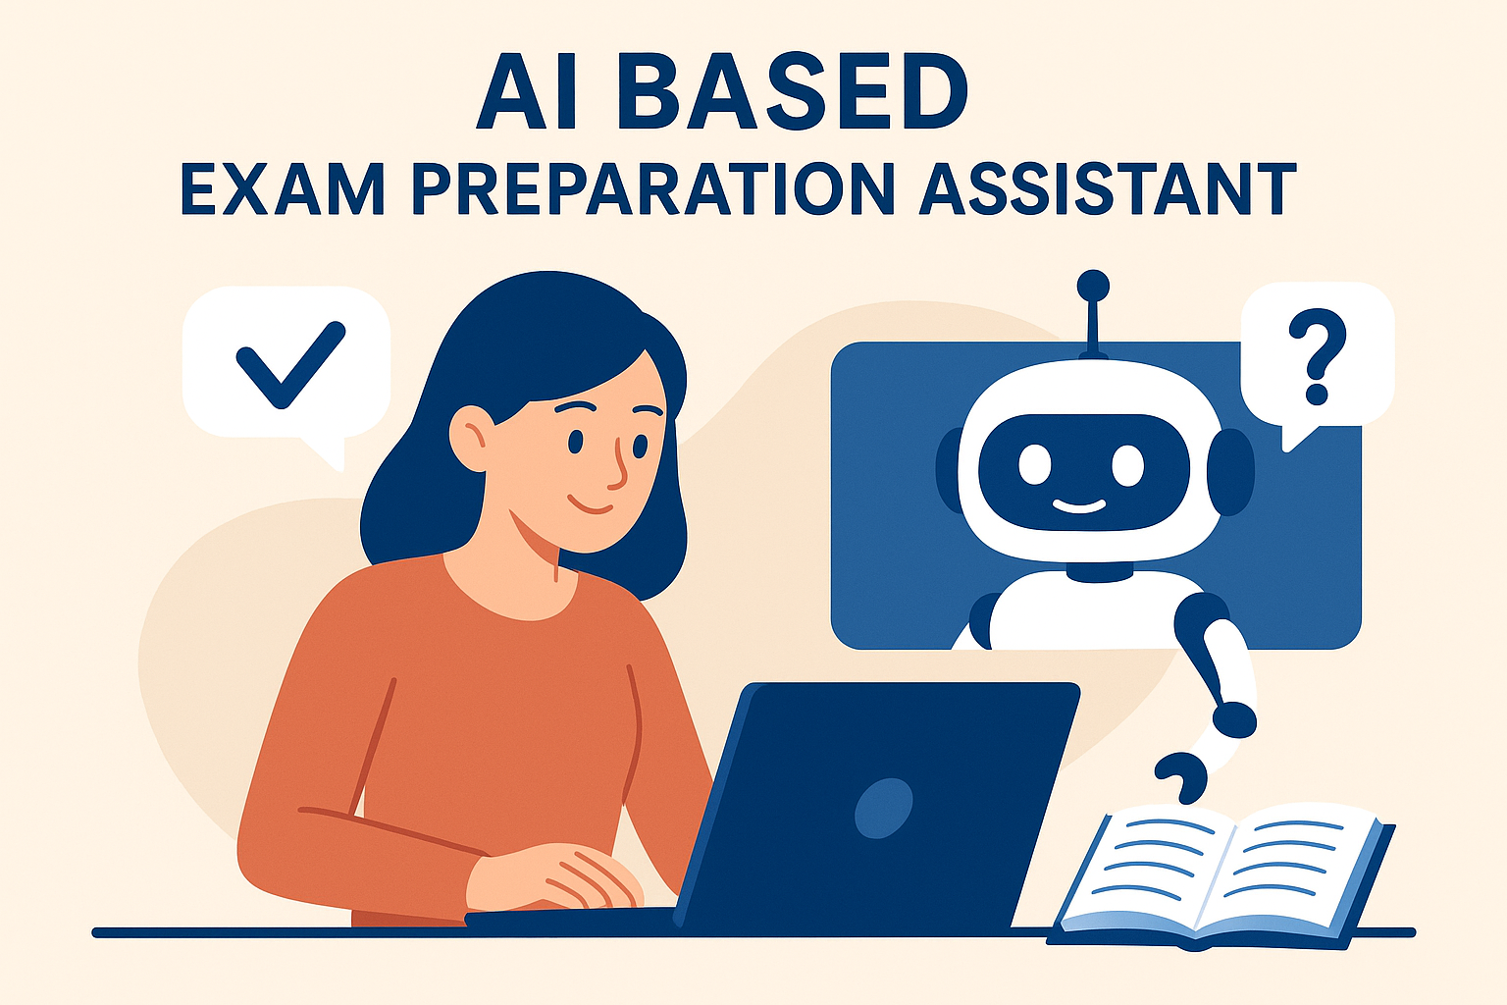
AI BASED EXAM PREPARATION ASSISTANT

Slide 2

Introduction to AI-Based Exam Preparation Assistant
An AI-based exam preparation assistant leverages artificial intelligence to help students prepare more effectively for exams.
It offers personalized study plans, adaptive learning, and instant feedback tailored to individual needs.
This technology aims to enhance learning efficiency and reduce exam anxiety for students.
Notes:
Image source: https://t3.ftcdn.net

Slide 3
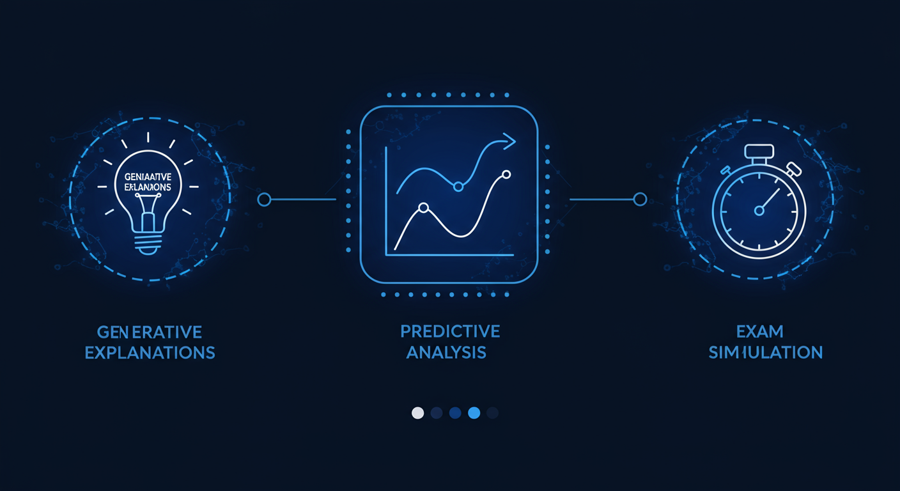
Key Features and Capabilities
The assistant provides customized practice questions based on the student's progress and areas of difficulty.
It can analyze student performance data to suggest targeted revision strategies and resources.
Real-time feedback and explanations help students understand their mistakes and improve their knowledge.
Notes:
Image source: https://t3.ftcdn.net

Slide 4
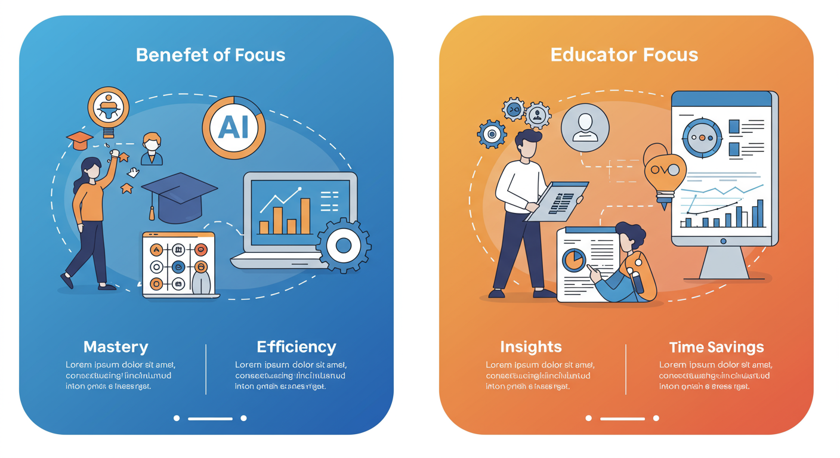
Benefits for Students and Educators
Students benefit from personalized learning experiences that adapt to their pace and learning style.
Educators can monitor student progress remotely and identify areas where additional support is needed.
The system promotes self-directed learning, increasing student engagement and confidence.
Notes:
Image source: https://t3.ftcdn.net

Slide 5
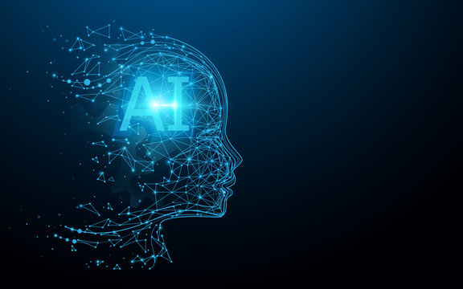
Future Outlook and Conclusion
AI-based exam preparation assistants are expected to become more sophisticated with advancements in machine learning.
Integration with virtual and augmented reality could offer immersive learning experiences.
Overall, these tools have the potential to transform traditional education and make exam preparation more accessible and effective.
Notes:
Image source: https://t3.ftcdn.net

